Slide 1
Intro to web technology

Slide 2
Workshop agenda
HTTP
HTML
CSS
JavaScript

Slide 3
HTML
Hypertext Markup Language is the document language used to define web content.

Slide 4
CSS
Cascading Style Sheets are the standard format for specifying layout and styling to be applied to an HTML document.

Slide 5
JavaScript
JavaScript is a programming language that can be used to enable dynamic behaviors to HTML documents.

Slide 6
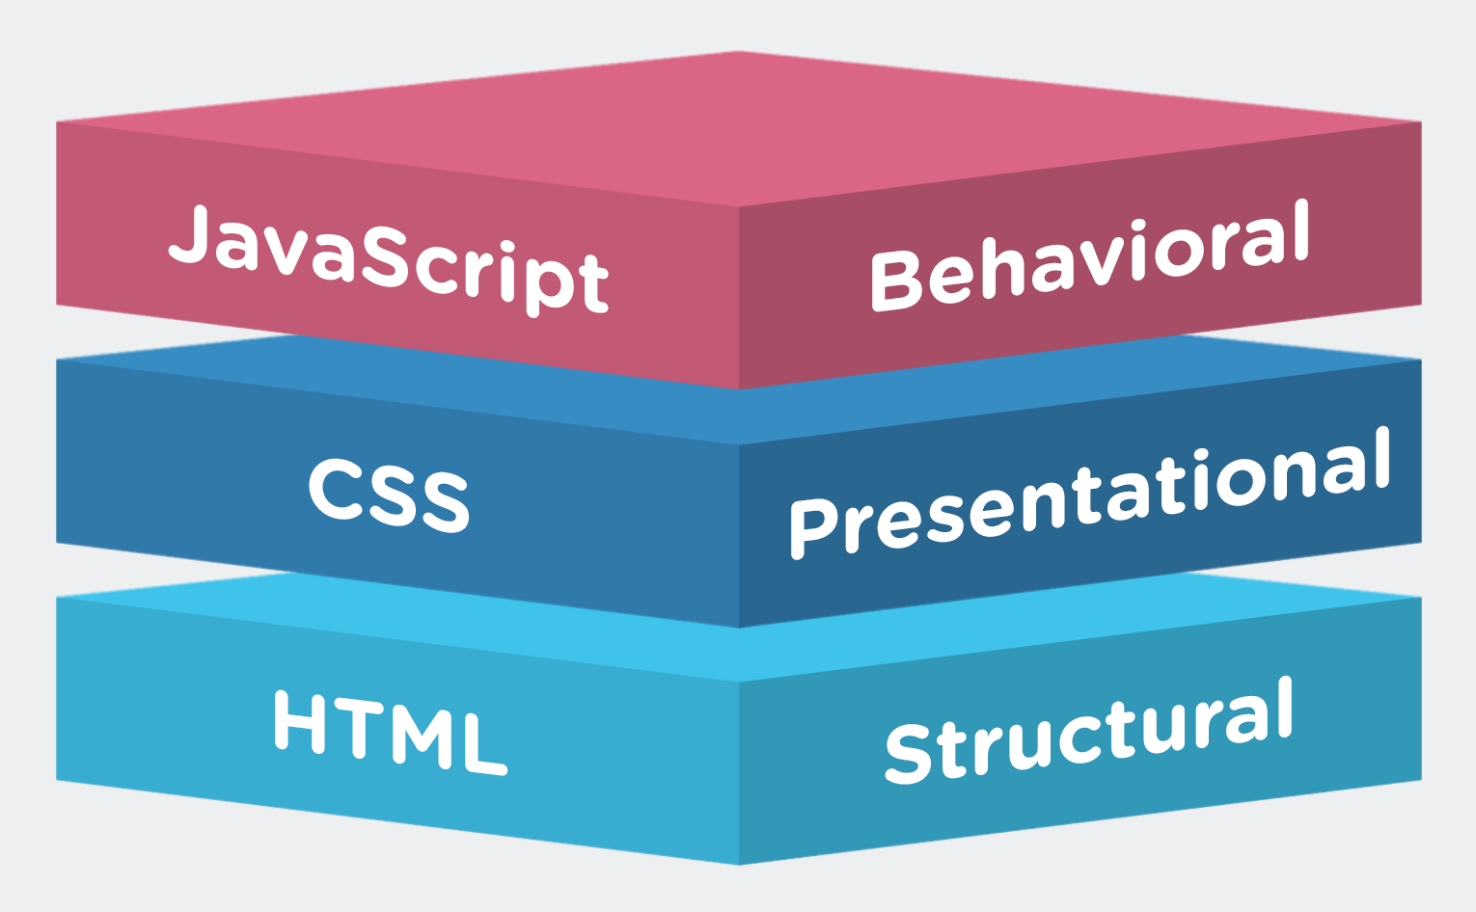
Web standards

Slide 7
<Angle><Brackets>

Slide 8

URLs

Slide 9
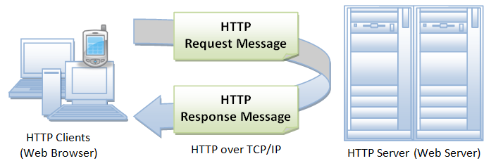
HTTP

Slide 10
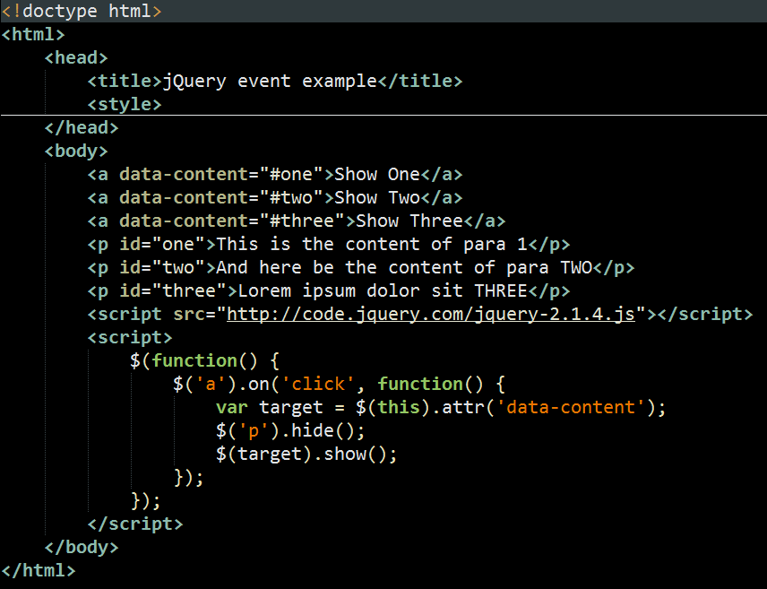
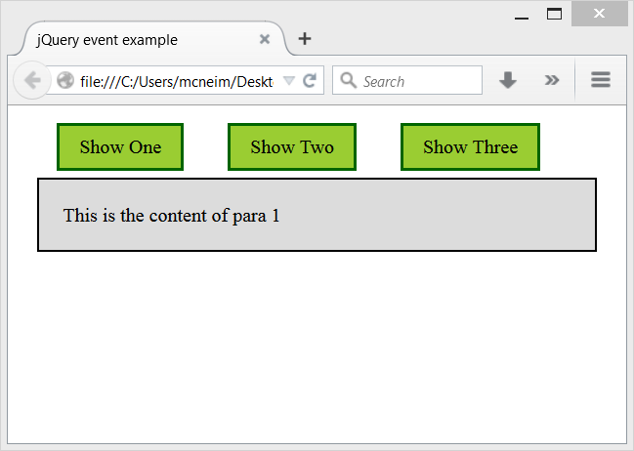
HTML Document

Slide 11
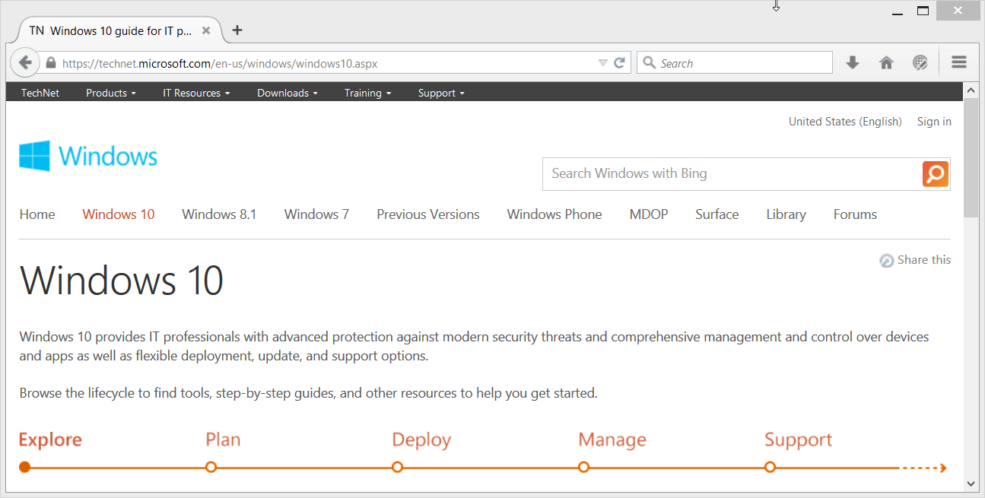
The Web is delivered as HTML

Slide 12
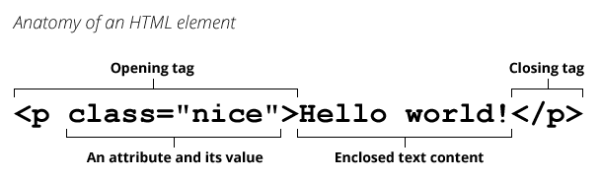
HTML Element

Slide 13
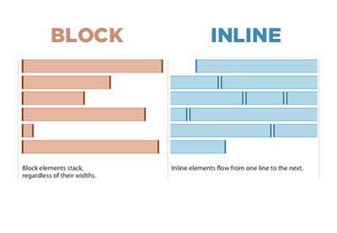
Block vs Inline elements

Slide 14
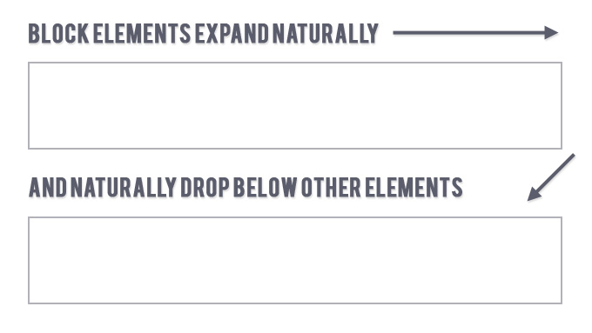
Block elements

Slide 15
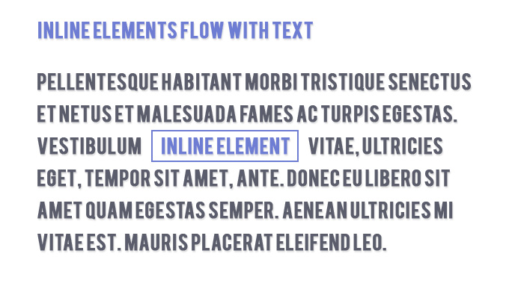
Inline Elements

Slide 16
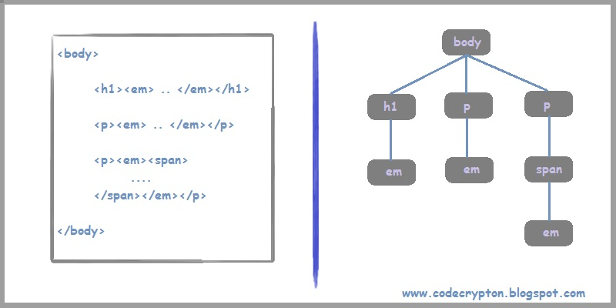
Element nesting – parents, children, ancestors, descendants

Slide 17
DOCTYPE declarations you don’t need to know
<!DOCTYPE HTML PUBLIC "-//W3C//DTD HTML 4.01//EN" "http://www.w3.org/TR/html4/strict.dtd">
<!DOCTYPE HTML PUBLIC "-//W3C//DTD HTML 4.01 Transitional//EN" "http://www.w3.org/TR/html4/loose.dtd">
<!DOCTYPE HTML PUBLIC "-//W3C//DTD HTML 4.01 Frameset//EN" "http://www.w3.org/TR/html4/frameset.dtd">
<?xml version="1.0" encoding="UTF-8"?>
<!DOCTYPE html
PUBLIC "-//W3C//DTD XHTML 1.0 Transitional//EN"
"http://www.w3.org/TR/xhtml1/DTD/xhtml1-transitional.dtd">

Slide 18
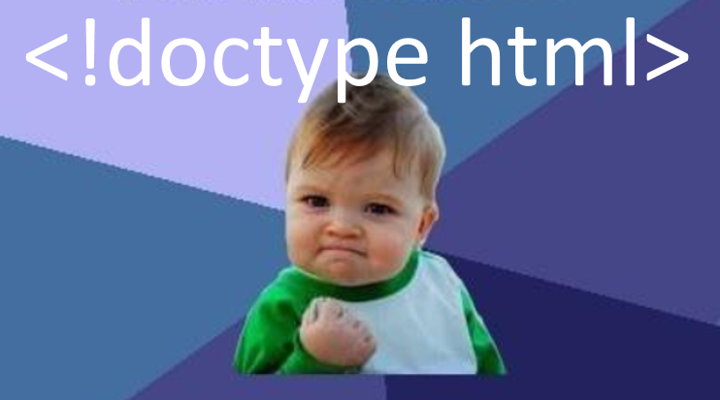
The only DOCTYPE declaration you need to know

Slide 19
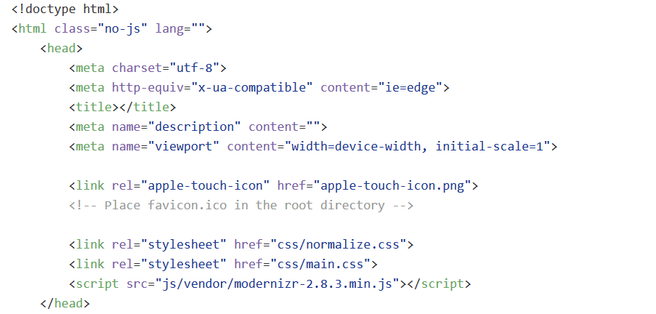
HTML <head>

Slide 20
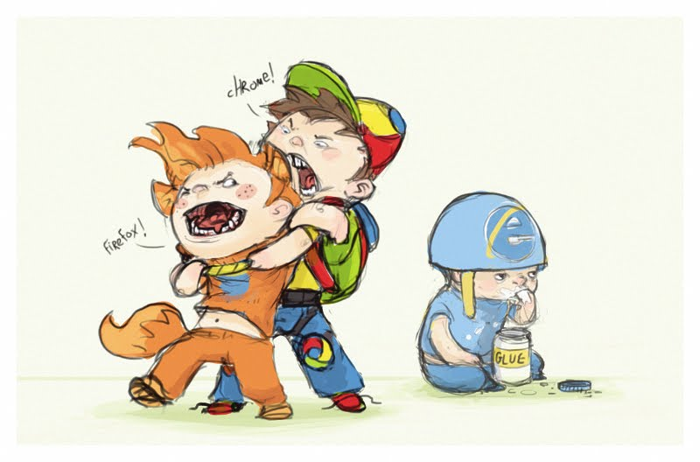

Slide 21
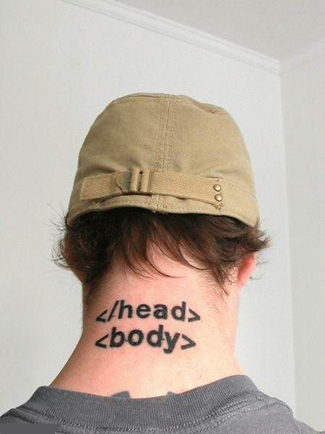

Slide 22
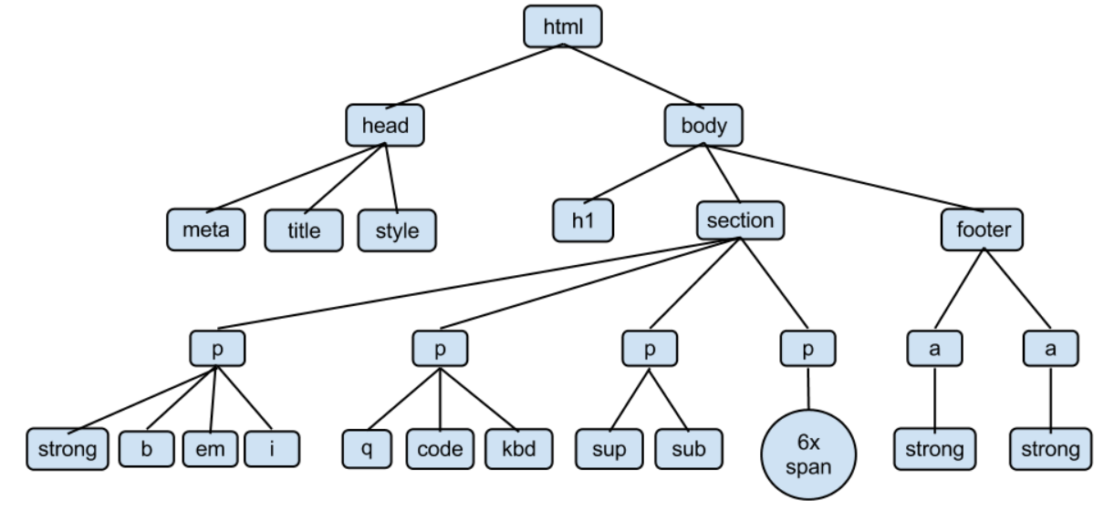
HTML <body>

Slide 23


HTML links: relative vs absolute

Slide 24
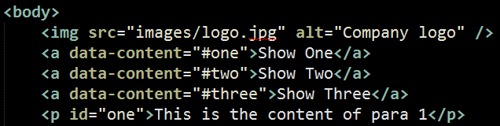

HTML <img> element

Slide 25
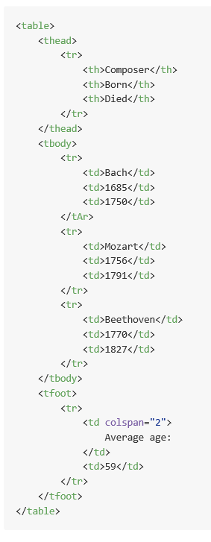
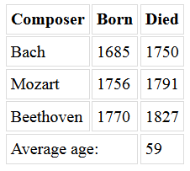
HTML <table> element

Slide 26
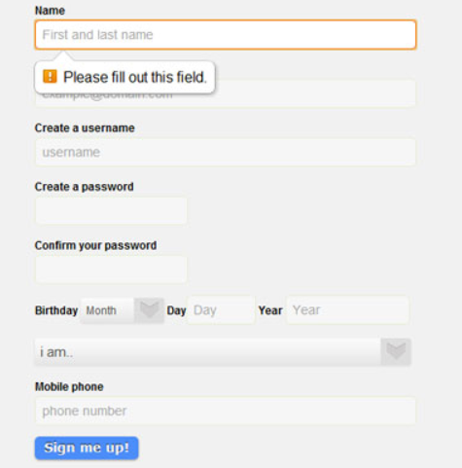
HTML <form> element

Slide 27
{ curly: braces }

Slide 28

YES! You *CAN* use <table> elements for layout!

Slide 30
Semicolons;

Slide 31
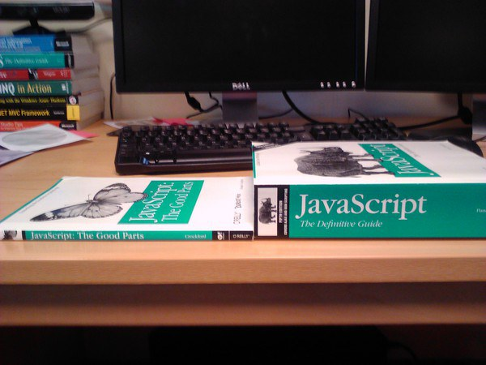

Slide 32
